Slide 1

Section A
Donovan Koh (2210698)

Slide 2
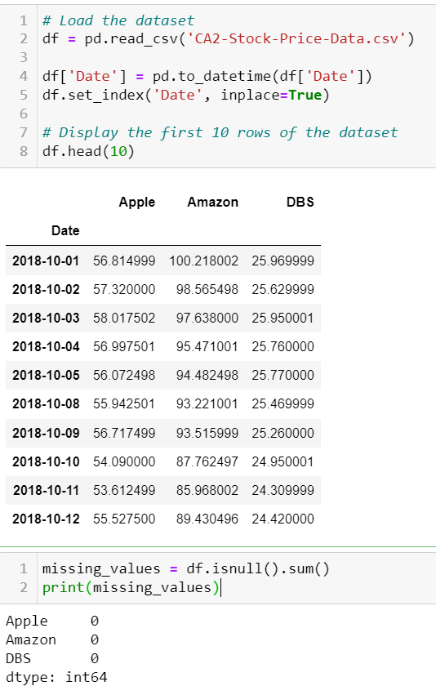
Data cleaning
Check if there is any missing values

Slide 3
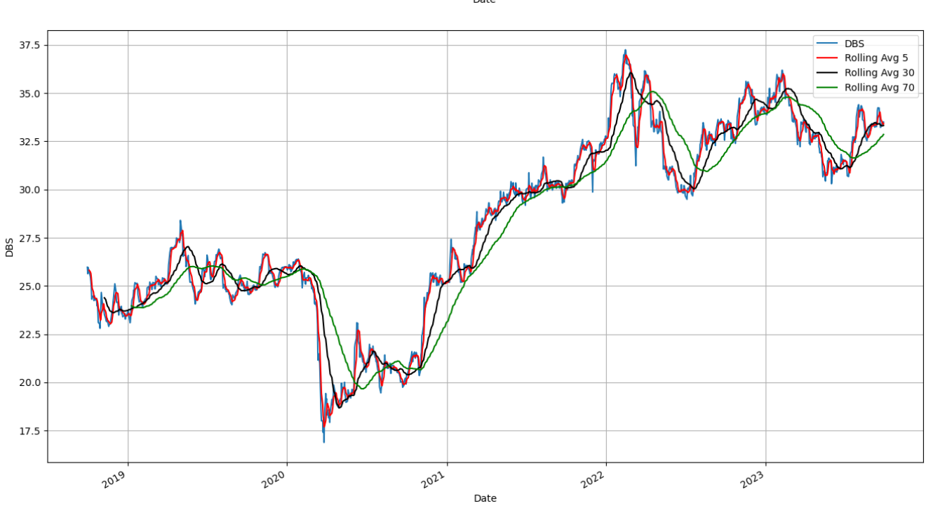
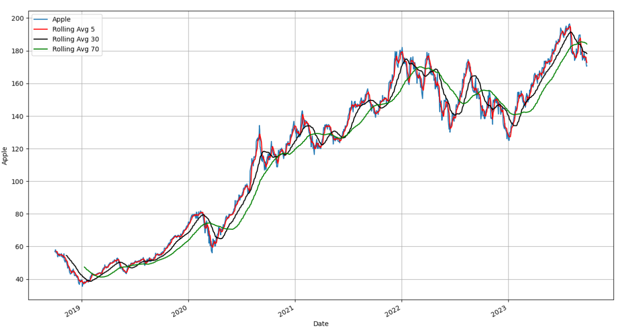
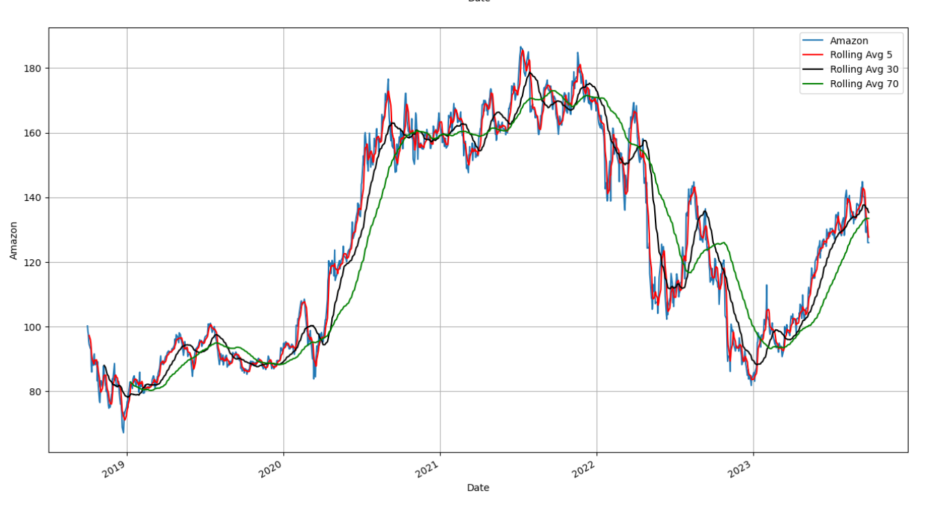
Generate rolling average for all stocks

Slide 4
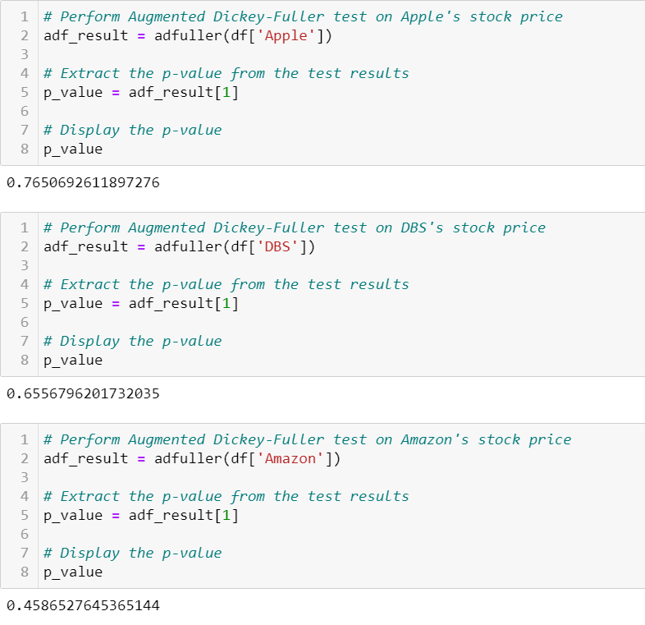
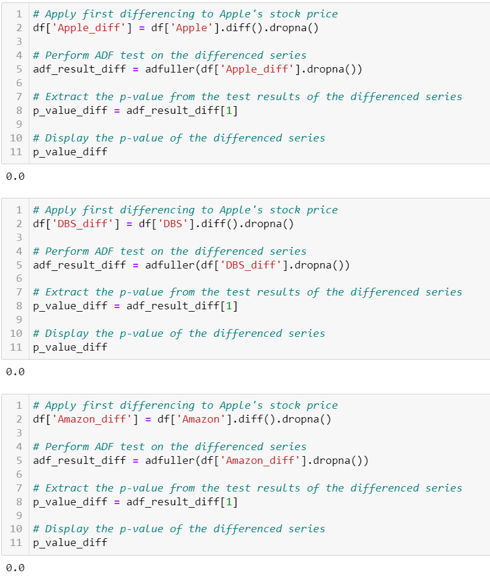

Slide 5
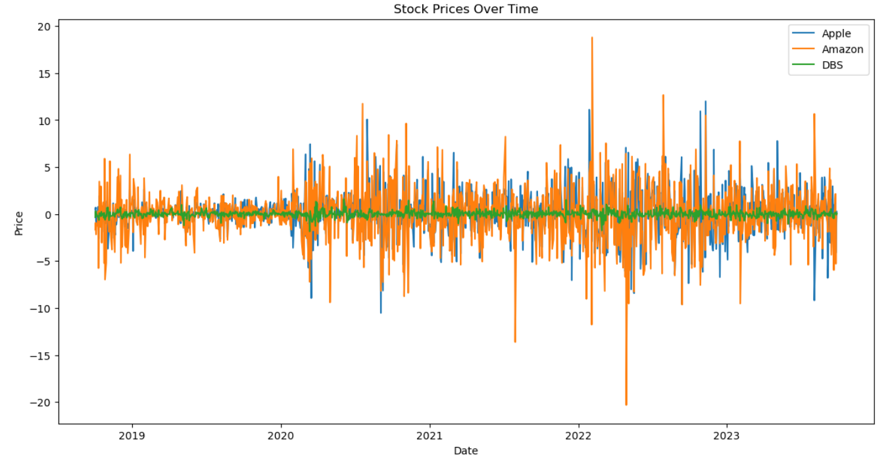
All three companies exhibit fluctuations in their stock prices.
There is no clear upward or downward trend for any of the companies during this period.

Slide 6
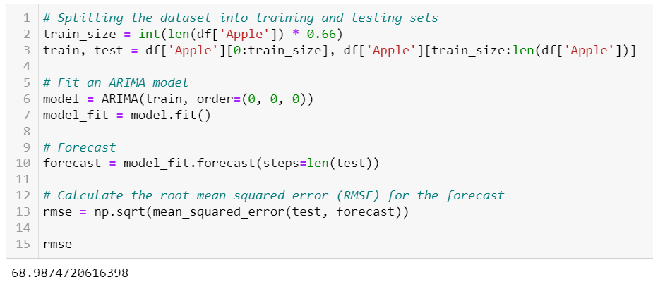
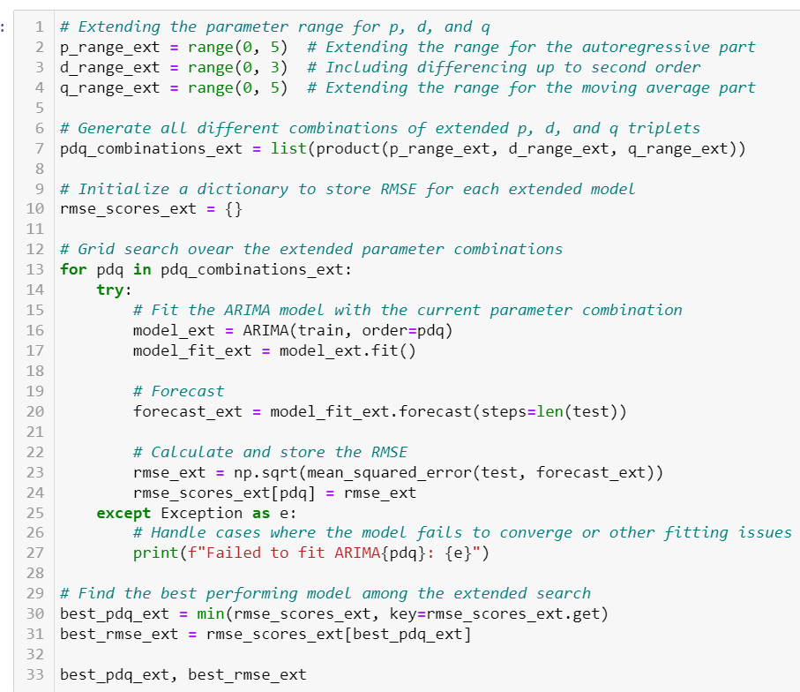
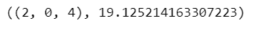
Split and train dataset
Best pdq params for Apple:
Best pdq params for DBS:
Best pdq params for Amazon:

Slide 7
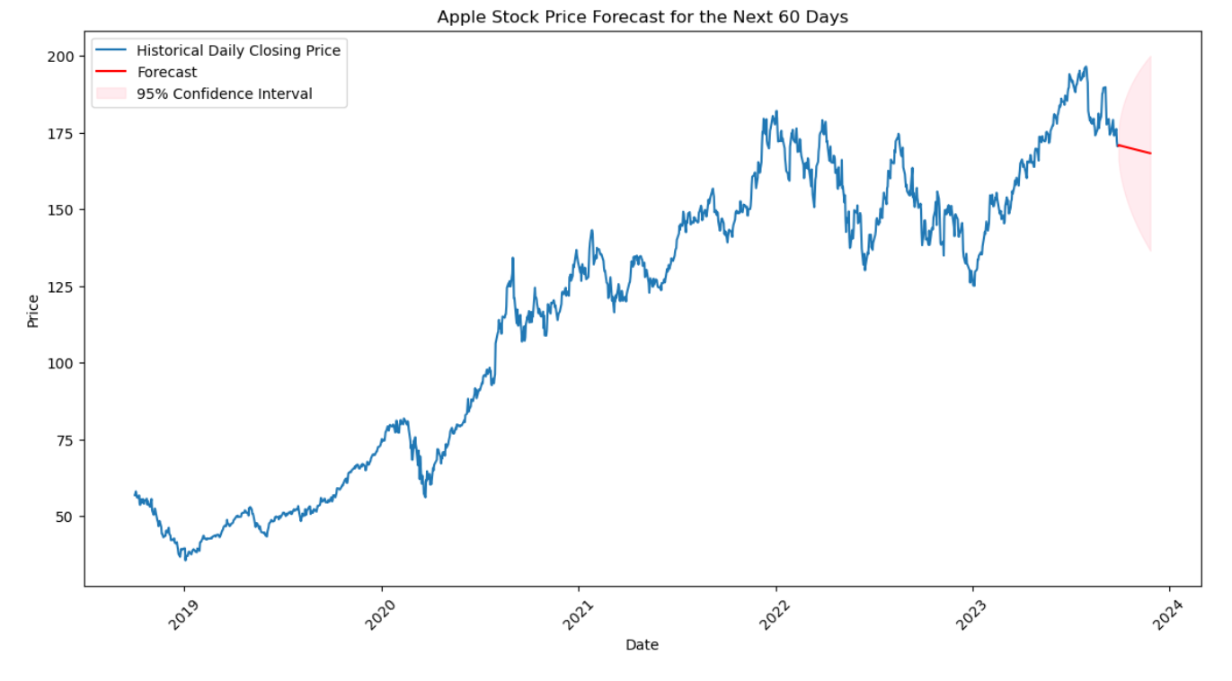
Plot graph using the pdq params
Forecast and Confidence Interval:
-The red line represents a forecast for the next 60 days.
-The shaded area around the forecast line represents a 95% confidence interval. This interval indicates the range of possible future stock prices.
-The forecast suggests a potential decline in the stock price during the upcoming period.

Slide 8
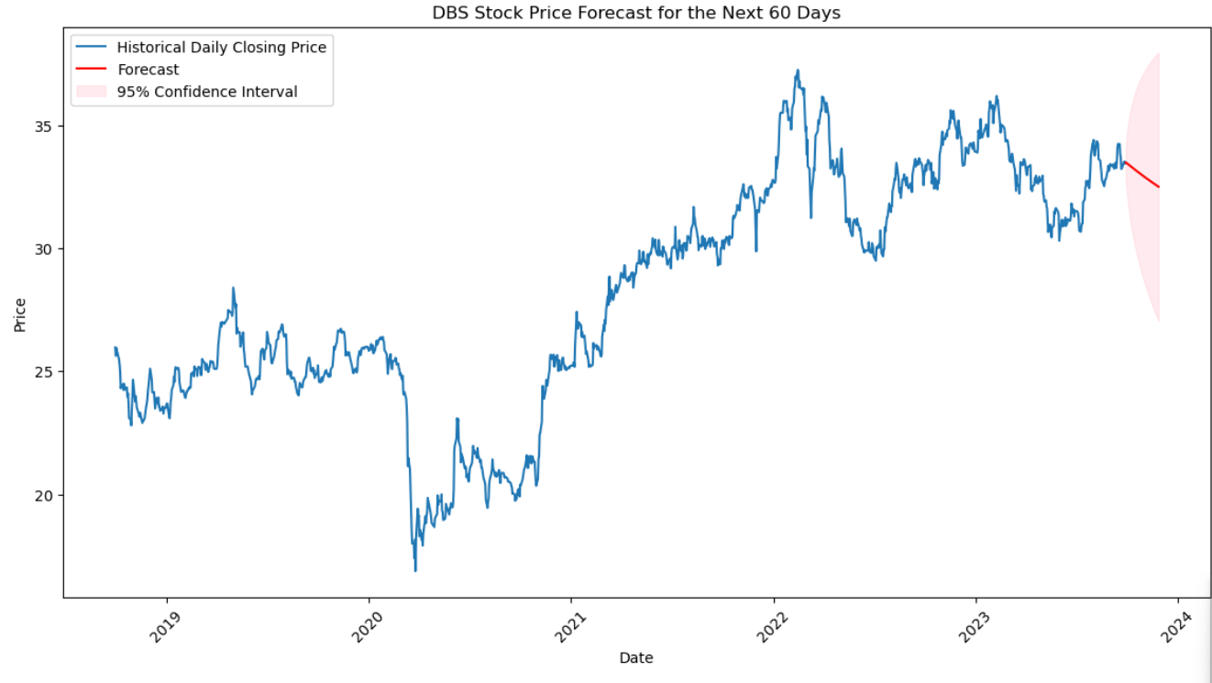
The forecast suggests that DBS’s stock price will maintain or decline its value around 30-35 in the coming days.

Slide 9
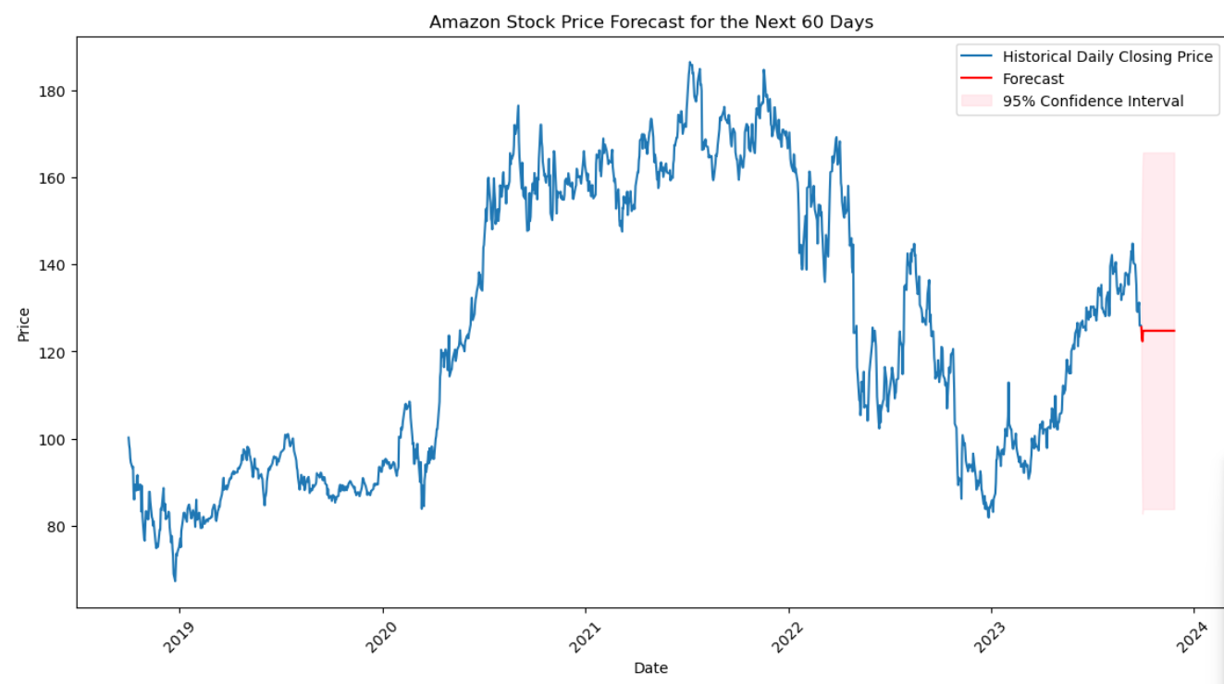
The forecast suggests an upward trajectory for Amazon’s stock price in the coming days.

